Slide 1
Algorithm Design and Analysis
NMU - Week 1_2

Slide 2
Agenda

Slide 3
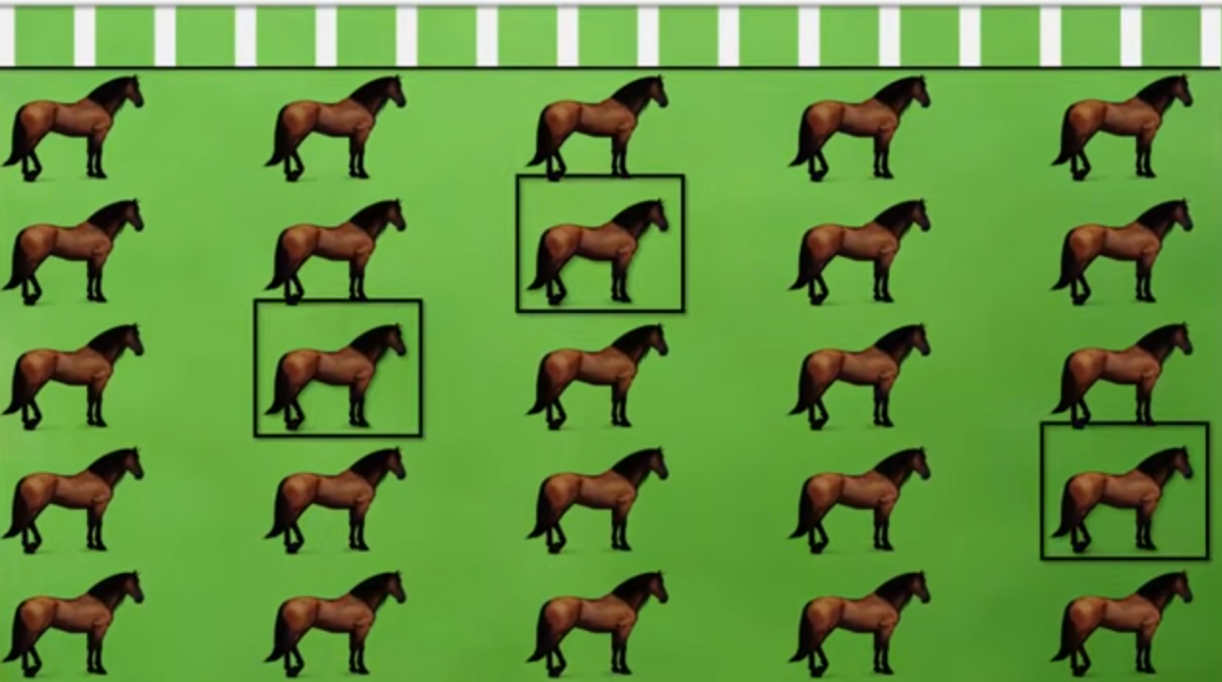
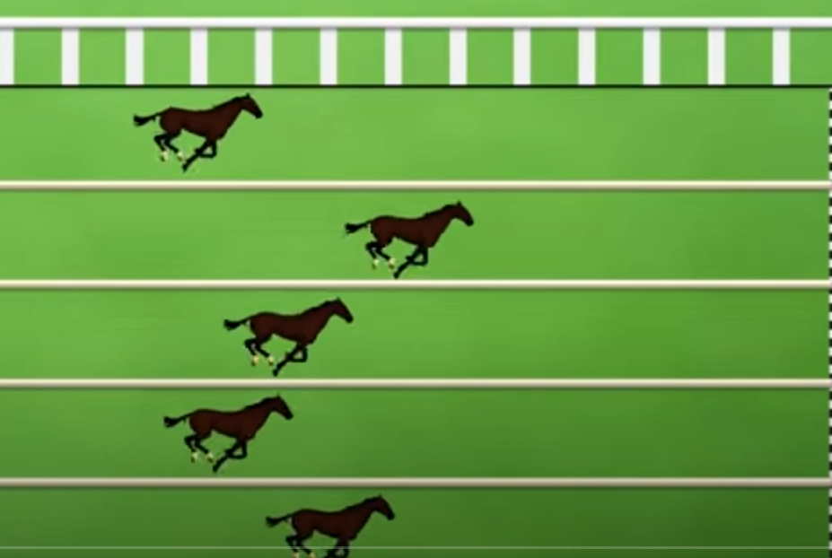
25 horse Race

Slide 4
Class Activity 1
Question:
From 25 horses, determine the three fastest
Only 5 horses can run at any one time.
You only know the order of the result
How many races that you have to arrange to find the 3 fastest horses?
Submit:
What are input/output/conditions?
Propose an algorithm to solve the problem? Please Explain + Show Example how our algorithm solve the problem.

